Slide 1

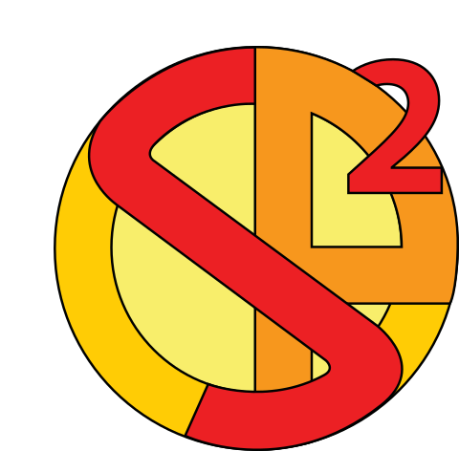
Diagnosing the Alfvén speed in asymmetric fibrils using solar magneto-seismology
Matthew Allcock Robertus Erdélyi

Slide 2
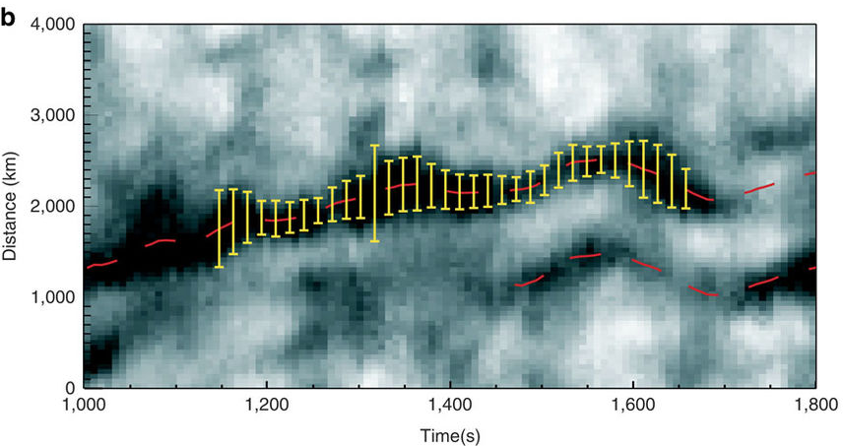
Asymmetric solar waves
Morton et al. 2012

Slide 3
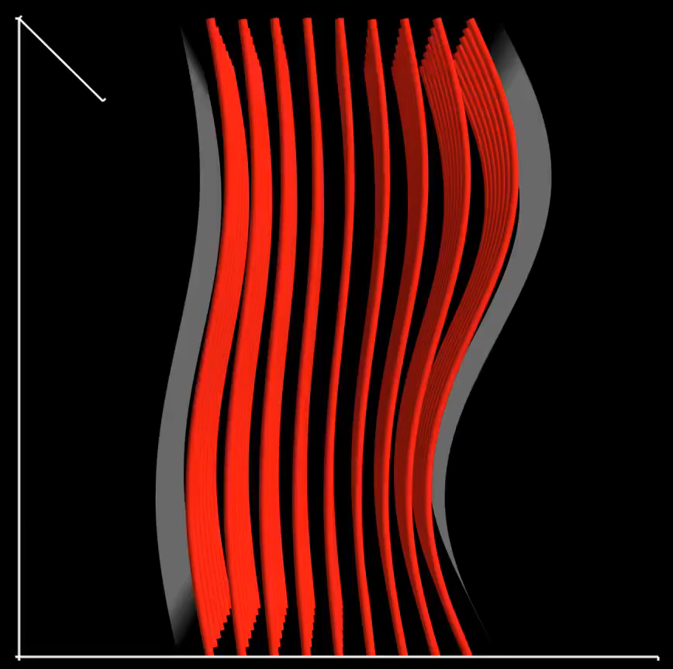
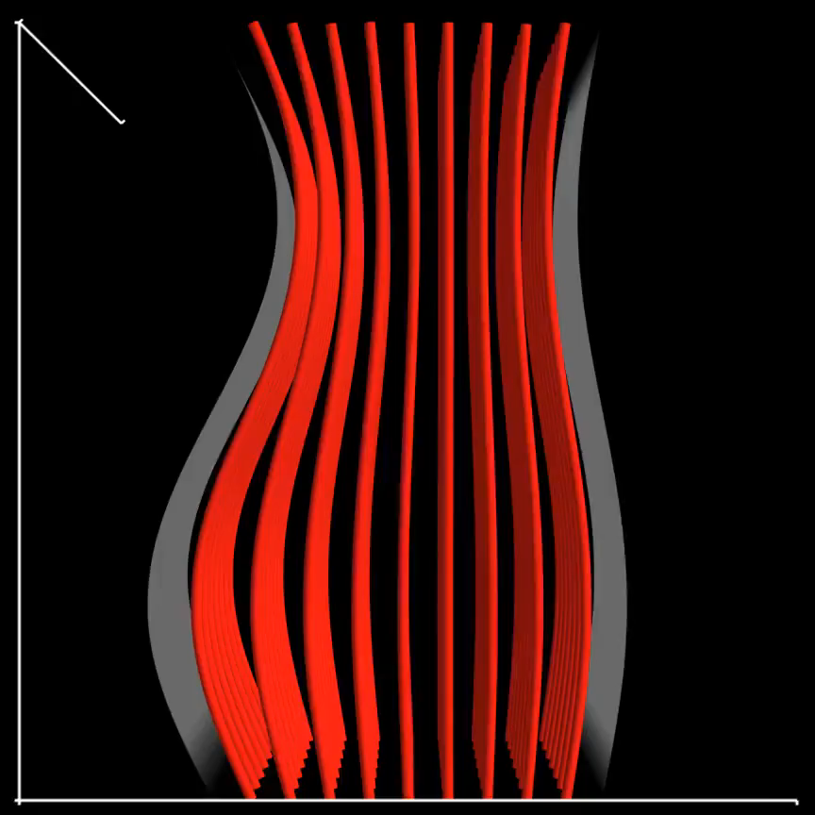
Asymmetric eigenmodes
*Allcock and Erdélyi, 2017:
bit.ly/2WcNzTo
Asymmetric kink mode Asymmetric sausage mode
100+ more videos available at:
swat.group.shef.ac.uk

Slide 4
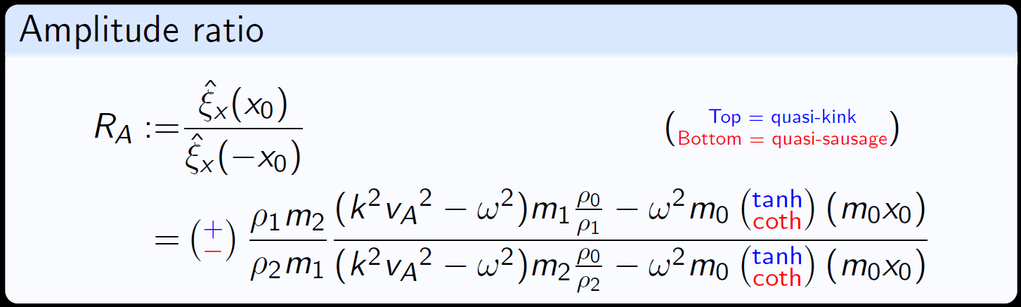
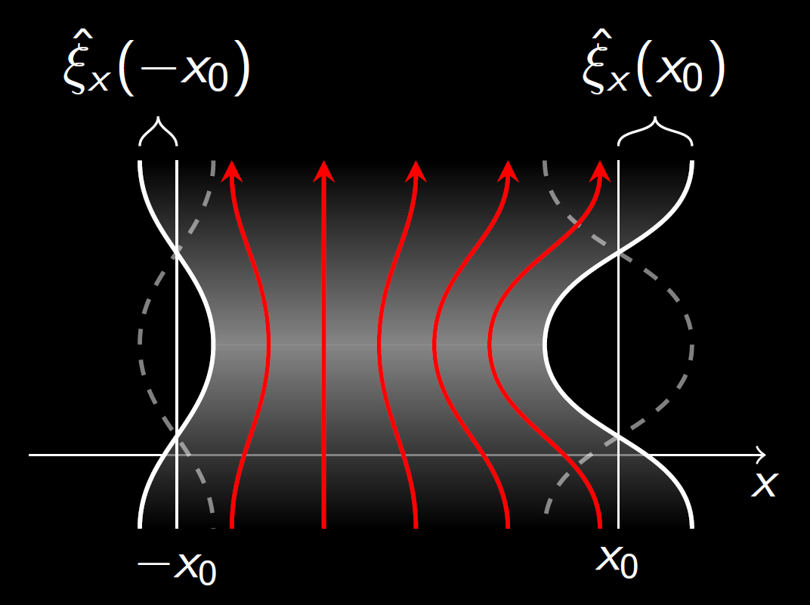

Amplitude Ratio
*Allcock and Erdélyi, 2018:
bit.ly/2LpwTr4
Boundary displacement
Parameter inversion:
Observe: $ω, k, x_{0}, T, R_{A}$,
Invert to estimate the Alfvén speed.*

Slide 5
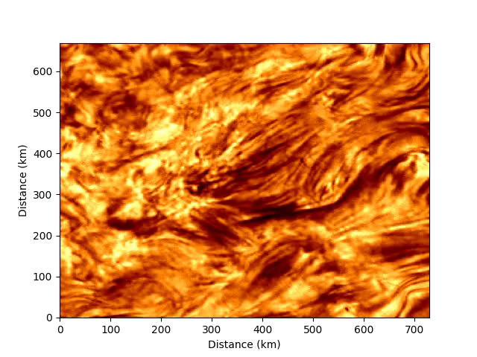
Diagnosis of chromospheric fibrils
Dataset info:
ROSA instrument (Dunn Solar Telescope).
Hα chromospheric inter-network.
Dark fine structures are fibrils that (approximately) map the magnetic field.
Spatial resolution ~ 150 km.
Temporal resolution ~ 8 s.

Slide 6
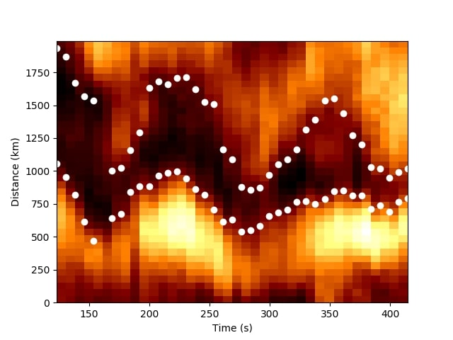
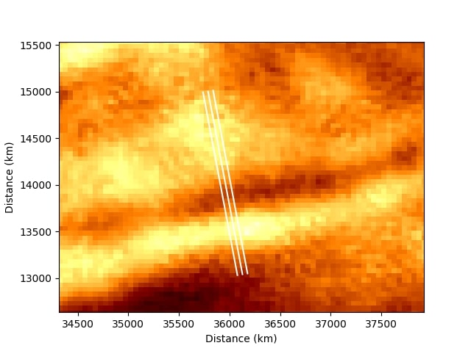
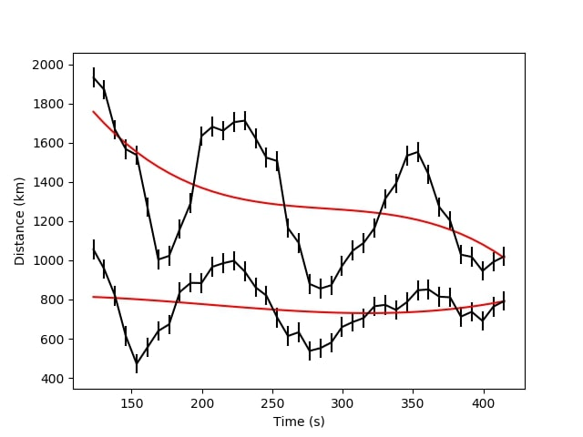
Diagnosis of chromospheric fibrils

Slide 7
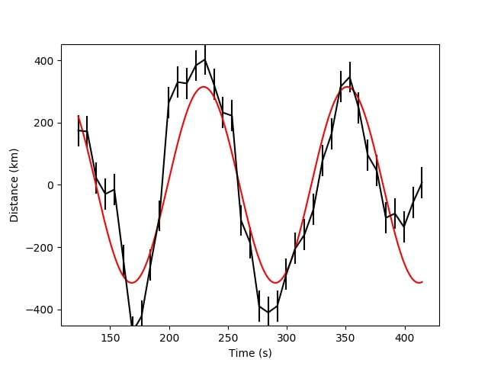


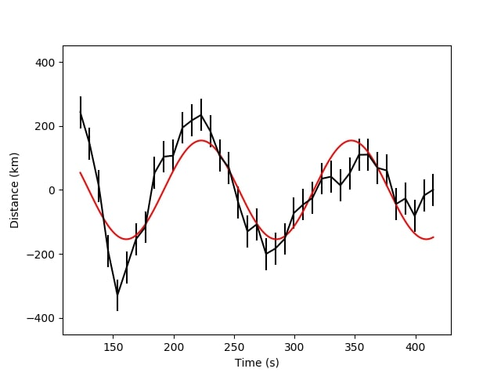

Parameter measurement – Amplitude ratio
Amplitude Ratio,

Slide 8
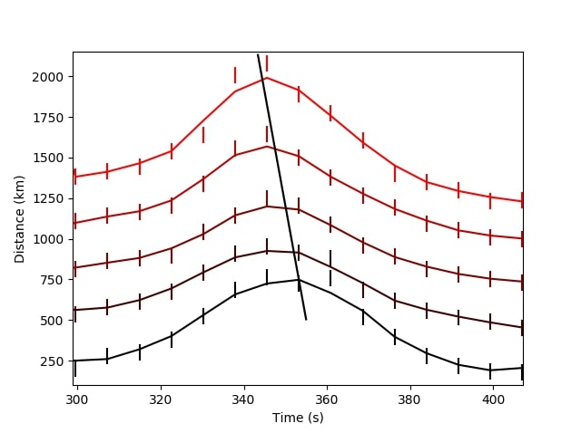
Parameter measurement - Phase speed
Gradient = Phase speed

Slide 9

Alfven speed inversion
*Open-source code available: bit.ly/2WgWmDX
Input parameters:
R_{A} ≈ 2.04
c_{ph} ≈ 129 km s⁻¹
x₀ ≈ 551 km
ω ≈ 0.0511 s⁻¹
Etc.
Substitute into:
Invert numerically*
v_{A} ≈ 63 km s⁻¹
Fibril | Amplitude ratio | Eigenmode | Estimated Alfvén speed, km s⁻¹
1 | 1.29 | Quasi-kink | 30.5
2 | -0.407 | Quasi-sausage | 91.7
3 | -3.42 | Quasi-sausage | 75.5
4 | -3.13 | Quasi-sausage | 49.4
5 | 2.04 | Quasi-kink | 63.1

Slide 10
Conclusions and further work
Asymmetry of MHD waves has seismological value.
The first use of magneto-seismology using solar waveguide asymmetry.
Agrees (in order of magnitude) with expected range.
Errors are significant and difficult to quantify errors.
Sub-structure resolution is possible and will become a more important tool in future.

